Slide 1
Recursion 2
Application

Slide 2
Recursion - application
Backtracking
it is used to search all possible solution of the problem
principle:
the solution is searched step by step; if the solution is found or the next step is not possible, the step back is done
it is more effective than brute force technique
typical task:
path searching in the labyrinth
8 Queens problem

Slide 3
8 Queens Problem
task:
place nonattacking 8 queens on 8x8 chess
principle:
place queen on the 1. row, 1 column
place next queen on the 2. row and 3. column
place next queen on the 3. row etc.
if it is not possible, return to the 2. row and try move queen to the next column
etc.

Slide 4
8 Queens Problem
demonstration: 4 Queens Problem

Slide 5
8 Queens Problem

Slide 6
8 Queens Problem
next queen can’t be placed, back step is executed

Slide 7
8 Queens Problem

Slide 8
8 Queens Problem

Slide 9
8 Queens Problem
next queen can’t be placed, back step is executed

Slide 10
8 Queens Problem

Slide 11
8 Queens Problem

Slide 12
8 Queens Problem

Slide 13
8 Queens Problem

Slide 14
8 Queens Problem

Slide 15
8 Queens Problem

Slide 16
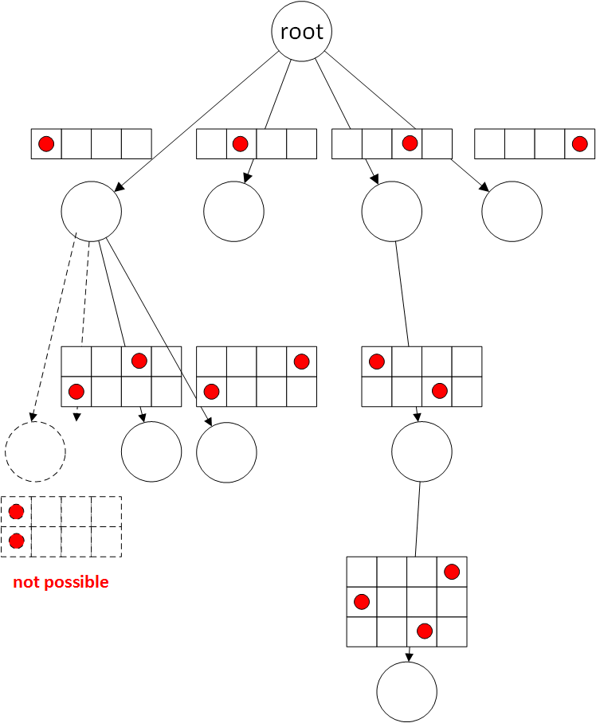
Tree of searched space

Slide 17
it must be implemented by recursion
or
the searching the solution space (tracing tree deep) must be done with stack in loop
states are stored/got to/from the stack
loop finishes when the stack is empty

Slide 18
Searching Path in Labyrinth
room[0][0]
room[1][0]

Slide 19
recursive backtracking algorithm
if it is possible, try to go to each “world side” in each room
if I found exit, print path and do step back
do step back, if it is not possible to go to some world side or you returned from all neighbouring rooms

Slide 20
How to create algorithm?
We create it in pseudocode.
Rules how to create recursive function:
stop condition
exit found or I can’t go to next room
simpler problem in recursive call
I go to next room (found path is longer)

Slide 21
go_to_room(where)
{
if (out_of) { print_path(); return; }
else
{
if (can_to_north) go_to_room(north);
if (can_to_south) go_to_room(south);
if (can_to_east) go_to_room(easth);
if (can_to_west) go_to_room(west);
}
}

Slide 22
Donald Knuth
Data + Algorithms = Programs
Think about data structures and algorithm!

Slide 23
labyrinth representation
width and length
dynamic two-dimensional array with info about rooms
typedef struct
{
int width, lenght;
TRoom **rooms;
} TLabyrinth;

Slide 24
room representation
info if “doors are opened” to each world side
typedef enum { CLOSED=0,OPENED=1 } TDoorState;
typedef struct
{
TDoorState north_door;
TDoorState south_door;
etc;
} TRoom;

Slide 25
how to store path (visited rooms within path)
the length of the path is not known in advance
back-tracking algorithm → if I enter to the next room I add the room to the end, if I do step back, I remove the room from the end of the path
double linked list
prevention against infinity loop
Boolean array with visited rooms
direct test: I will not enter the room from which I came

Slide 26
header of recursive procedure
void go_to_room(TLabyrinth *labyrinth,
TWorldSides where_to_go,
int x, int y,
TPath *path);

Slide 27
Task – Domino game
Domino tile has two fields. Each field can be empty or it can contain 1 – 6 points.
Tiles are put into chain so that neighbouring tiles have the same count of points in adjacent tiles. No tile can be joined to the tile with empty field.
Create program which reads set of tiles from the file (each row contains pair of numbers 0 – 6 representing one tile), tiles with the same count of points can repeat in the file. The program writes the longest chain which can be created from the set and the count of tiles in the chain.

Slide 28
Divide and Conquer
principle:
divide state space into two (several) smaller subspaces
solve the problem on each (smaller) space – recursively
merge solutions
task:
Towers of Hanoi
sorting: QuickSort

